Slide 1
Online Voting System
Kulmeet Singh
2016827
Mentor Name : Dr. Surendra Kumar Shukla

Slide 2
Contents
Introduction
Methodology
XAMPP
PHP

Slide 3
Introduction
The word "vote" means to choose, select, or specify from a list. The main purpose of voting (in scenarios involving citizens of a particular country) is to find leaders of their choice. And the process of voting in an election is called a poll. The Online Voting System is an online website with key features related to the GUI and database properties that determine software requirements for this project. This project is intended for small voting processes such as college elections and feedback forms. This project provides an online tool to vote on various questions submitted by admins/organizers. The purpose of this document is to help you understand the practical and non-functional requirements of an online survey system. It also works for the purpose of clarifying functionality to the end user.

Slide 4
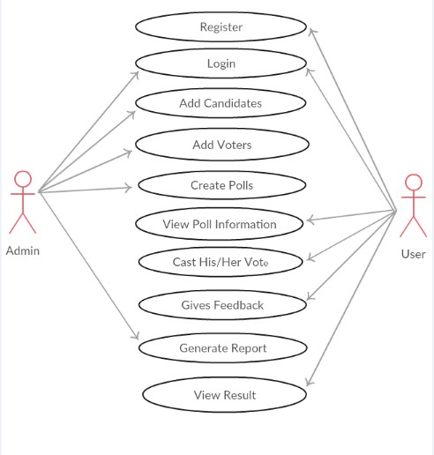
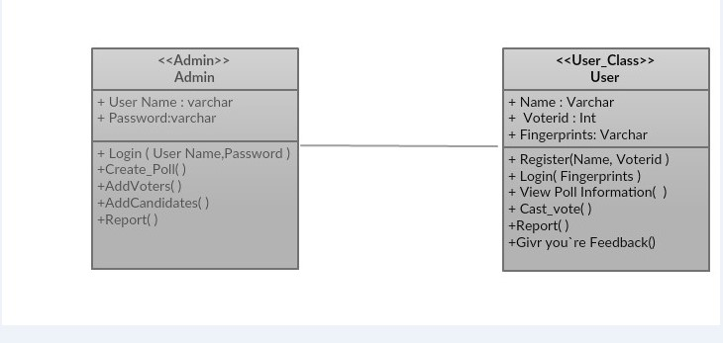
Methodology

Slide 5
XAMPP
XAMPP is an abbreviation where X stands for Cross-Platform, A stands for Apache, M stands for MYSQL, and the Ps stand for PHP and Perl, respectively. It is an open-source package of web solutions that includes Apache distribution for many servers and command-line executables along with modules such as Apache server, MariaDB, PHP, and Perl.
XAMPP helps a local host or server to test its website and clients via computers and laptops before releasing it to the main server. It is a platform that furnishes a suitable environment to test and verify the working of projects based on Apache, Perl, MySQL database, and PHP through the system of the host itself. Among these technologies, Perl is a programming language used for web development, PHP is a backend scripting language, and MariaDB is the most vividly used database developed by MySQL. The detailed description of these components is given below.

Slide 6
Voting is the expression of our commitment to ourselves, one another, this country, and this world.
“
”
Sharon Salzberg

Slide 7
PHP
PHP is an open-source, interpreted, and object-oriented scripting language that can be executed at the server-side. PHP is well suited for web development. Therefore, it is used to develop web applications (an application that executes on the server and generates the dynamic page.).
PHP was created by Rasmus Lerdorf in 1994 but appeared in the market in 1995. PHP 7.4.0 is the latest version of PHP, which was released on 28 November.

Slide 8
Some important points need to be noticed about PHP are as followed:
PHP stands for Hypertext Preprocessor.
PHP is an interpreted language, i.e., there is no need for compilation.
PHP is faster than other scripting languages, for example, ASP and JSP.
PHP is a server-side scripting language, which is used to manage the dynamic content of the website.
PHP can be embedded into HTML.
PHP is an object-oriented language.
PHP is an open-source scripting language.
PHP is simple and easy to learn language.

Slide 9
Thank you

